Slide 1
Internship Report and Project Presentation
Diwali Sales Analysis
Team Name : Team GPA
Member Name : Prajwal, Rudra, Nikul
Internship Duration : 24 June 2024 to 5 August 2024
Company: IBM

Slide 2
Overview of Internship
Company : IBM Skill Build
Collaborating : CSRBOX
Role : Data Analyst Intern
Duration: [24/06/2024 – 05/08/2024]

Slide 3
Role and Responsibilities
Analyzing data to provide insights
Using tools like Excel, SQL, Python, and Power BI
Collaborating with different departments to understand data needs

Slide 4
Project Overview: Diwali Sales Analysis
Project Objective :
Analyze sales data during Diwali season to identify trends and insights
Data Sources :
Sales records
Customer demographics
Promotional data

Slide 5
Methodology
Data Collection
Sources : https://github.com/PrajwalYadav07/Diwali-Sales-Analysis
Tools
Jupyter Notebook
Python Programing Language
MS Excel
Analytical Techniques
Techniques used: time series analysis, regression analysis, etc.

Slide 6
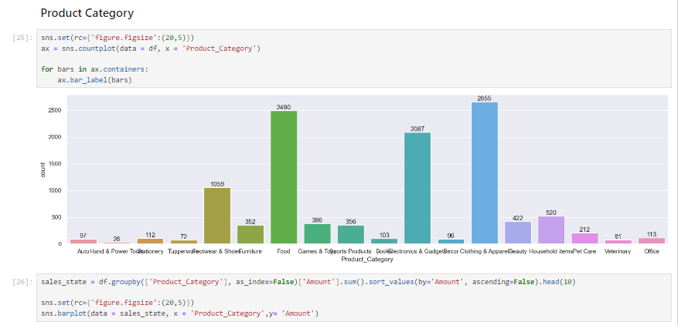
Findings and Insights
Major Trends and Patterns

Slide 7
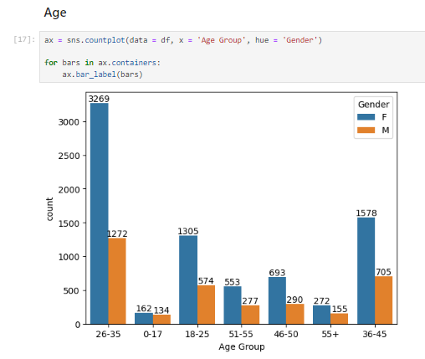
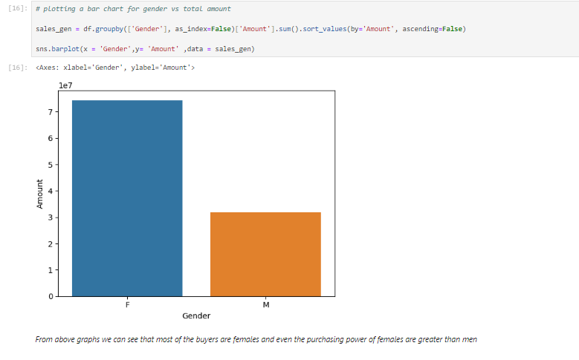
Findings and Insights
Age Group & Gender

Slide 8
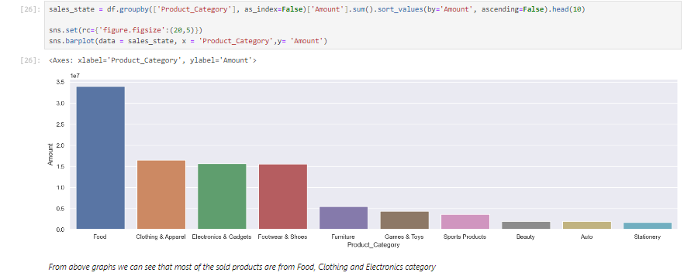
Detailed Analysis
Sales Analysis :

Slide 9
Project Learnings
Performed data cleaning and manipulation
Conducted exploratory data analysis (EDA) using pandas, matplotlib, and seaborn libraries
Improved customer experience by identifying potential customers across different states, occupations, genders, and age groups
Enhanced sales by identifying the most selling product categories and products, aiding in inventory planning to meet demands

Slide 10
Thank You….

